Slide 1

Android
IS413
Introduction

Slide 2
IS 413 Android Programming for Mobile Applications
Today’s Agenda:
Introduction to Android and IntelliJ
Preparing Lab Computers
Starting our ABC’s

Slide 3
Introduction to Android and IntelliJ
Android in IntelliJ on Java
Setting up your computer in the lab
Creating a Working Directory
Setting up your own Computer.
Downloads and installs
JAVA SDK
Android SDK
IntelliJ
See Android- Getting Started Document on Google Drive

Slide 4
Some Considerations
IntelliJ can be used to develop programs in a number of underlying languages but we need the Java base with the Android SDK
Since there are a WHOLE lot of things happening behind the scenes with the GUI view of Android programming keep in mind that a lot of linked parts are being created- This is why you start in IntelliJ by creating a
File>New>Project > pick Android SDK
A Project contains a group of files and links

Slide 5
Notes on Android Boot Camp ABC-Chapter 1
Android has changed from Eclipse+Android plug-in to Android Studio which is IntelliJ+Android – the other SDK template interfaces.
Eclipse Projects can be IMPORTED to IntelliJ- in the process they get converted to the newer format.
The Android Interfaces for both Eclipse and IntelliJ are very similar so there should only be a modicum of adjustment for Eclipsers.

Slide 6
Where to put your project
Project Package Name .where.who.what
To store your projects-
Are you a lumper or splitter
Do you have a USB Flash drive?
Are you hoping to remember that the lab computers can use the D:/temp directory but it gets shared and wiped clean?
Did you remember that you only have rights to your own Documents Library in the lab and not the C: drive
Creating the app once is easy- finding it again for object reuse is challenging

Slide 7
Reminders
The Project View Window gives you access to the package’s folders and files
Since we are in a GUI environment IntelliJ stores the layout in the main.xml file which by default starts as a LinearLayout
You are probably better off sticking with most of the defaults unless told otherwise for the first app. After that you should experiment to set up the apps for your own device.

Slide 8
Observations
RelativeLayout and TableLayout are better GUI tools for supporting a variety of displays
http://developer.android.com/guide/practices/screens_support.html
Low resolution images don’t scale well
IntelliJ also supports auto-complete functions while directly programming lines of code in XML-
This is good for people who hate drag and drop simplicity and want to feel like they are really programming by writing lines of text code but they sometimes forget how to spell.

Slide 9
Package Names
Since Android apps are meant to be published/sold by companies- package names are listed in reverse URL order from what a company would publish
For you- you can have any package name you want- I’d suggest something like:
edu.yourname.whichapp
Activities
Java applications start at the “main” method- Android apps start at a “MainActivity”

Slide 10
AVD
To test an app you run it in a virtual android environment known as an Emulator which is defined by an Android Virtual Device. This way a Windows or Mac OS machine can behave as if it is an Android phone or tablet
In the lab your AVD’s are limited and you can’t change them much.
And by the way- an Android Emulator can take MINUTES to load- kind of hard to tell if it has failed or if it is just slowwwww

Slide 11
Objectives
In this chapter, you learn to:
Understand the market for Android applications
Identify the role of the Android device in the mobile market
Describe the features of the Android phone
Identify which languages are used in Android development
Describe the role of Google Play in the mobile marketplace

Slide 12
Objectives (continued)
Create an Android project using Android Studio
Explain the role of the Android project view
Specify the use of layout and widget controls in the user interface
Execute an Android application on an emulator
Open a saved Android project in Android Studio

Slide 13
Meet the Android
Apps
Mobile applications created for smartphones
Open-Source operating system
No company or individual defines the features or direction of the development
Open Handset Alliance
80 firms that develop standards for mobile devices

Slide 14
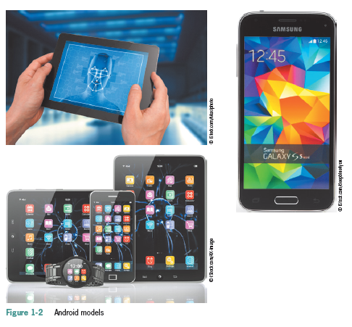
Meet the Android (continued)
Android Phone Device
Most popular are Moto X, Galaxy, Droid, Xperia, OnePlus, Nexus and HTC One
OS also powers tablets, netbooks, e-readers, MP4 players and Internet TVs
Emulator
Duplicates how the app looks and feels on a particular device

Slide 15
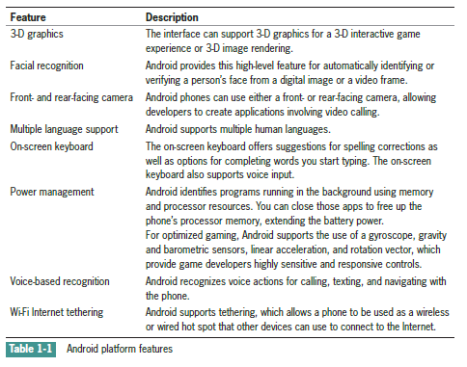
Meet the Android (continued)

Slide 16
Meet the Android (continued)
Writing Android Apps
Java is an Object-oriented programming language patterned after the C++ language
Android Studio
An integrated development environment (IDE) for building and integrating application development tools and open-source projects.
Android Studio IDE is exclusively dedicated to the purpose of creating Android applications
Includes the Android Software Development Kit (SDK)
XML is used to assist in the layout of the Android emulator

Slide 17
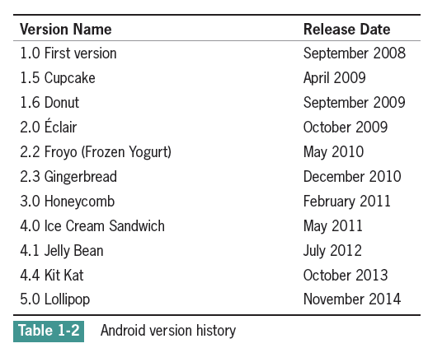
Meet the Android (continued)
Android Emulator
Design, develop, prototype, and test Android apps without using a physical device
Mimics almost every feature of a real Android handset, except placing phone calls

Slide 18
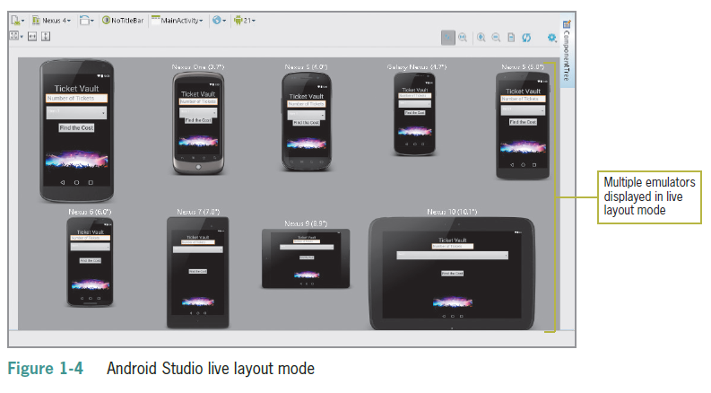
Meet the Android (continued)

Slide 19
Getting Oriented with Market Deployment
Getting Oriented with Market Deployment
Platform consists of the Android OS, application development tools, and a marketplace Apps are compiled into package files with an .apk extension
Google Play (http://play.google.com) sells and deploys all apps
Programs must meet minimum standards
Apps are free or paid (70/30 split between developer and wireless carrier)
Also sold through Amazon (amazon.com/appstore) and iTunes (both charge a $99 registration fee)

Slide 20
Opening Android Studio to Create a New Project
Download and install the Android Studio from https://developer.android.com/sdk/index.html
You’ll need an Application name, Company domain, package name, Project location, Form factor, Minimum SDK, Activity and activity name
Creating the Hello World Project
Open the Android Studio program
Create a new project, name it, supply a company domain and location

Slide 21
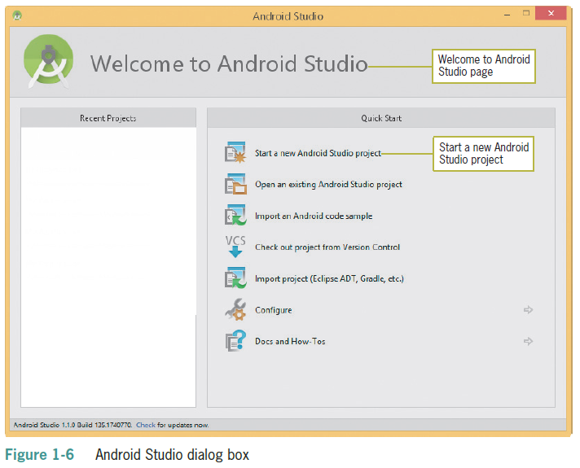
Opening Android Studio to Create a New Project (cont’d)

Slide 22
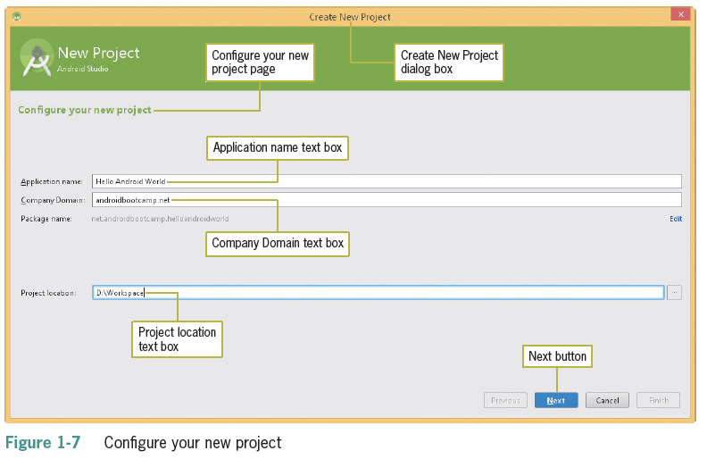
Opening Android Studio to Create a New Project (cont’d)

Slide 23
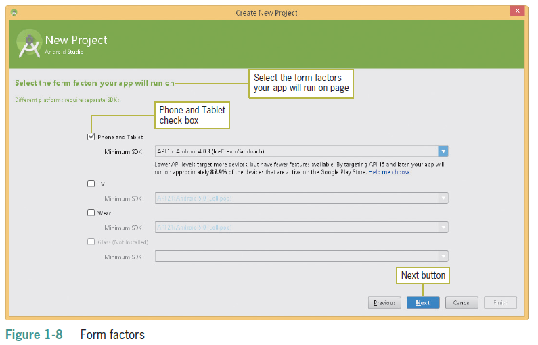
Opening Android Studio to Create a New Project (cont’d)

Slide 24
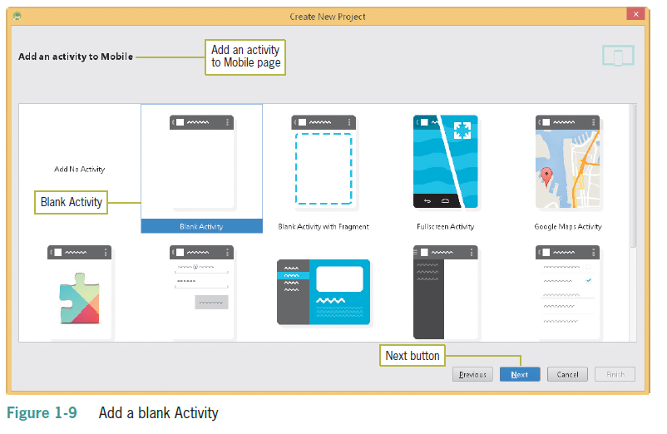
Opening Android Studio to Create a New Project (cont’d)

Slide 25
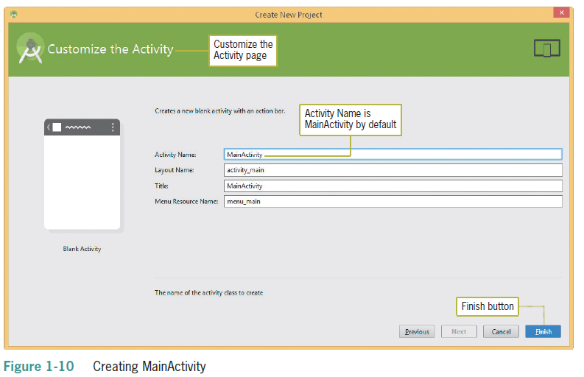
Opening Android Studio to Create a New Project (cont’d)

Slide 26
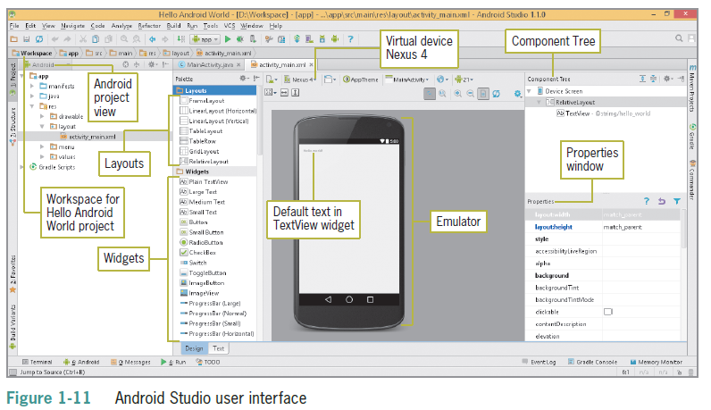
Opening Android Studio to Create a New Project (cont’d)

Slide 27
Building the User Interface
Must be intuitive
Interface must not distract from functionality
Java code or XML layout files are needed
XML method is preferred
Can design interface without writing large amounts of code

Slide 28
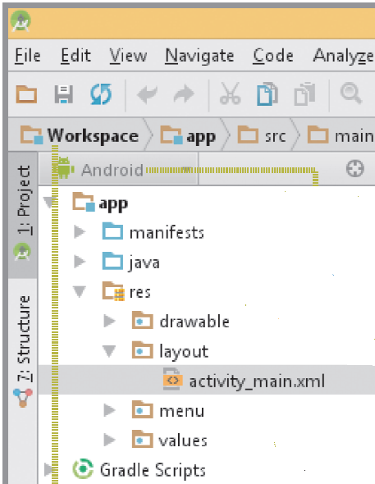
Taking a Tour of the Android Project View
Java folder – contains Java source code
Res folder – contains images, music, and video
Manifests folder contains the Android Manifest.xml – which contains information about the application that Android needs to run

Slide 29
Designing the User Interface Layout within the Virtual Device
Layout – a container that holds as many widgets as needed
Widget– a single element on the screen (Button, Text Box, etc.)
The Properties pane contains the properties of the currently active app project or object
Android Studio displays an emulator configuration for design and layout purposes called the Android Virtual Device (AVD)

Slide 30
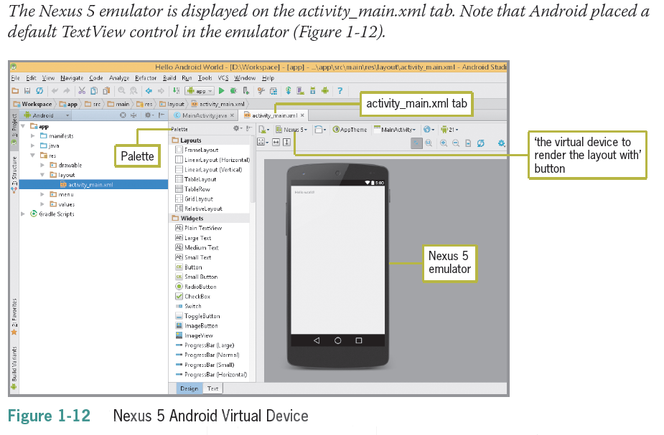
Designing the User Interface Layout within the Virtual Device (Cont’d.)
Step 1: Tap or click ‘the virtual device to render the layout with’ button (the emulator button) directly to the right of the Palette on the activity_main.xml tab, and then tap or click Nexus 5 (5.0”, 1080 x 1920, xxhdpi).

Slide 31
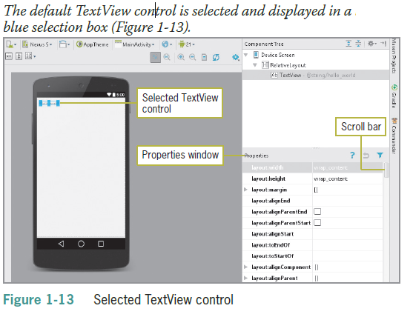
Designing the User Interface Layout within the Virtual Device (Cont’d.)
Step 2: In the emulator, select the default TextView control, which reads Hello World!

Slide 32
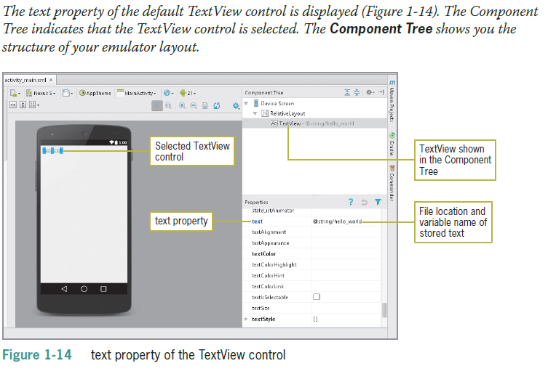
Designing the User Interface Layout within the Virtual Device (Cont’d.)
Step 3: Scroll down the Properties pane to display the text property

Slide 33
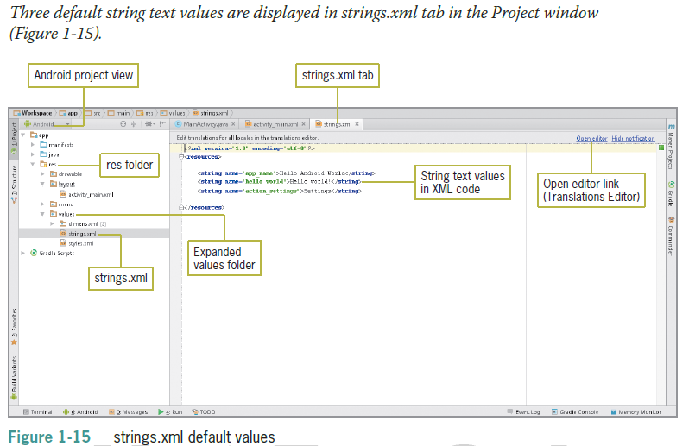
Modifying the Text in the TextView Control
Step 1: In the Android project view, tap or click the expand arrow for the values subfolder in the res folder to expand the folder’s contents
Double-tap or double-click the strings.xml file to display the strings.xml tab in the Project window

Slide 34
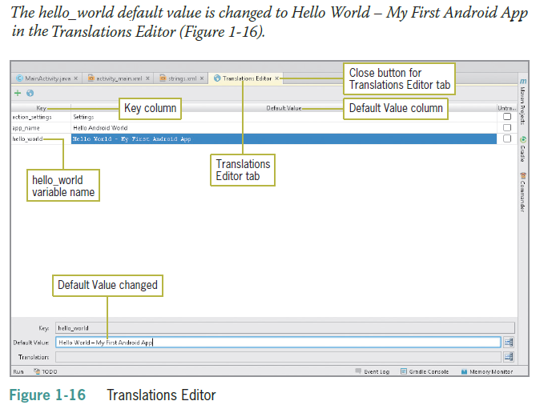
Modifying the Text in the TextView Control (Cont’d.)
Step 2: Tap or click the Open editor link on the right side of the Project window to display the Translations Editor tab
Tap or click the Default Value (Hello world!) to the right of the hello_world Key column in the Translations Editor
At the bottom of the Translations Editor tab, type Hello World – My First Android App in the Default Value text box

Slide 35
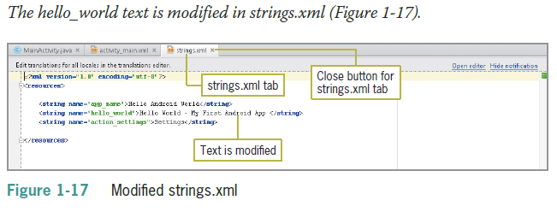
Modifying the Text in the TextView Control (Cont’d.)
Step 3: Close the Translations Editor window by tapping or clicking the Close button on the Translations Editor tab

Slide 36
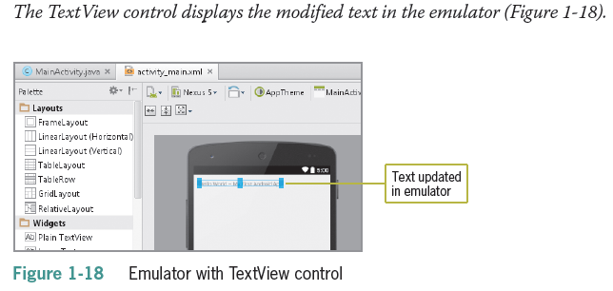
Modifying the Text in the TextView Control (Cont’d.)
Step 4: Close the strings.xml tab by tapping or clicking its Close button

Slide 37
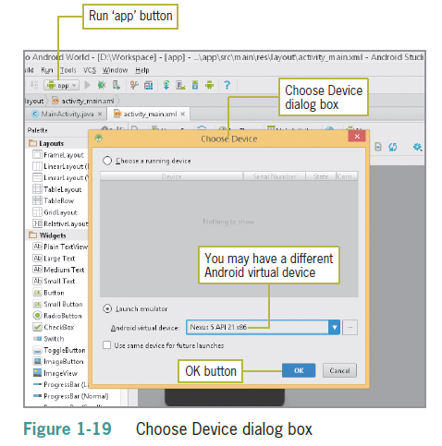
Testing the Application in the Emulator
Step 1: Tap or click the Run ‘app’ button on the toolbar

Slide 38
Testing the Application in the Emulator (Cont’d.)
Step 2: If necessary, select Nexus 5 API 21 x86 (or a recent version emulator) in the Android virtual device list
Tap or click the OK button in the Choose Device dialog box

Slide 39
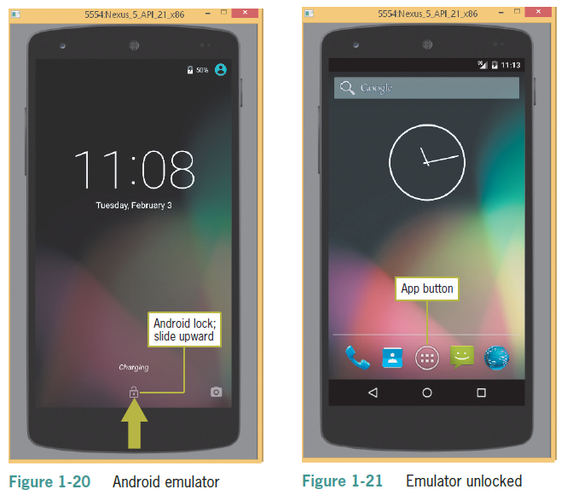
Testing the Application in the Emulator (Cont’d.)
Step 3: Tap or click the lock icon and slide it upward toward the time in the vertical center of the screen to unlock the virtual device
(If you are using a Mac, drag the lock icon until it changes to an unlock icon)

Slide 40
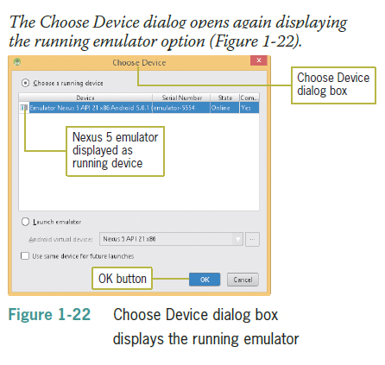
Testing the Application in the Emulator (Cont’d.)
Step 4: Tap or click the Run ‘app’ button on the toolbar again to launch the code into the opened emulator
Step 5: Tap or click the OK button in the Choose Device dialog box
Step 6 – Close the emulator and the project

Slide 41
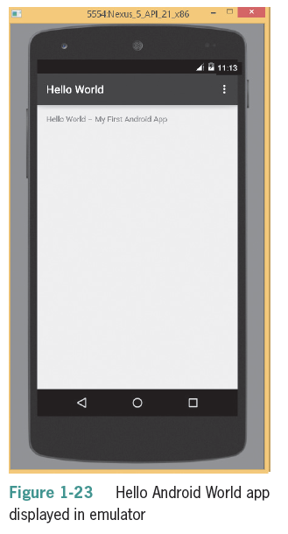
Opening a Saved App in Android Studio
Step 1: Open Android Studio
Tap or click the Hello Android World project in the Recent Projects column ( If the project is not listed in the Recent Projects, tap or click Open an existing Android Project in the Quick Start column and navigate to the path of the saved project and tap or click the OK button

Slide 42
Summary
Android OS is released under a full open-source license for free
Android OS powers all types of mobile devices
To write apps, you can use Android Studio, a dedicated development environment for building Android applications, using Java
The Android emulator lets you design, develop prototype, and test Android applications
The Android platform consists of the Android OS, the Android application development platform, and Google Play - the Android marketplace

Slide 43
Summary (continued)
Android supports both Java code and XML layout files, although XML is preferred
The Android project view on the left side of the Android Studio program window contains the folders for an Android project
To design a user interface for an Android app, you can create a layout containing widgets (objects)
The text property can be updated using the Translations Editor
You can test applications in the Android emulator to make sure they run correctly

